Slide 1
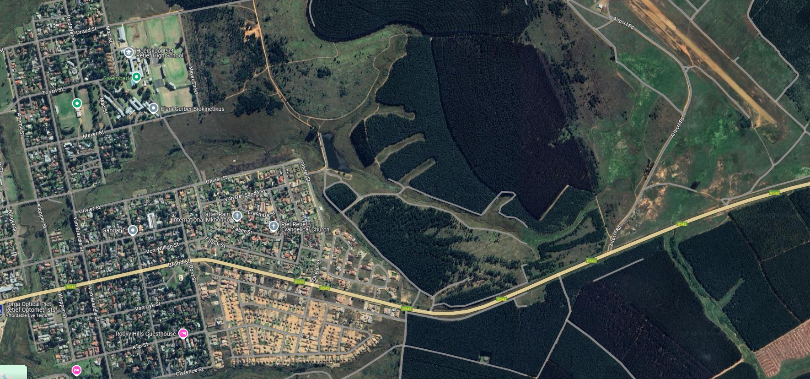
Assegaai Marathon Route Map - 2026
End
Start
Finish

Slide 2
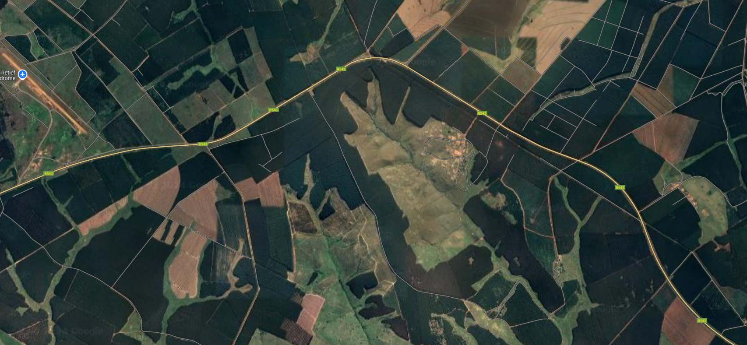
Assegaai Marathon Route Map - 2026
Continue to Assegaai River
Return to Rugby Club

Slide 3
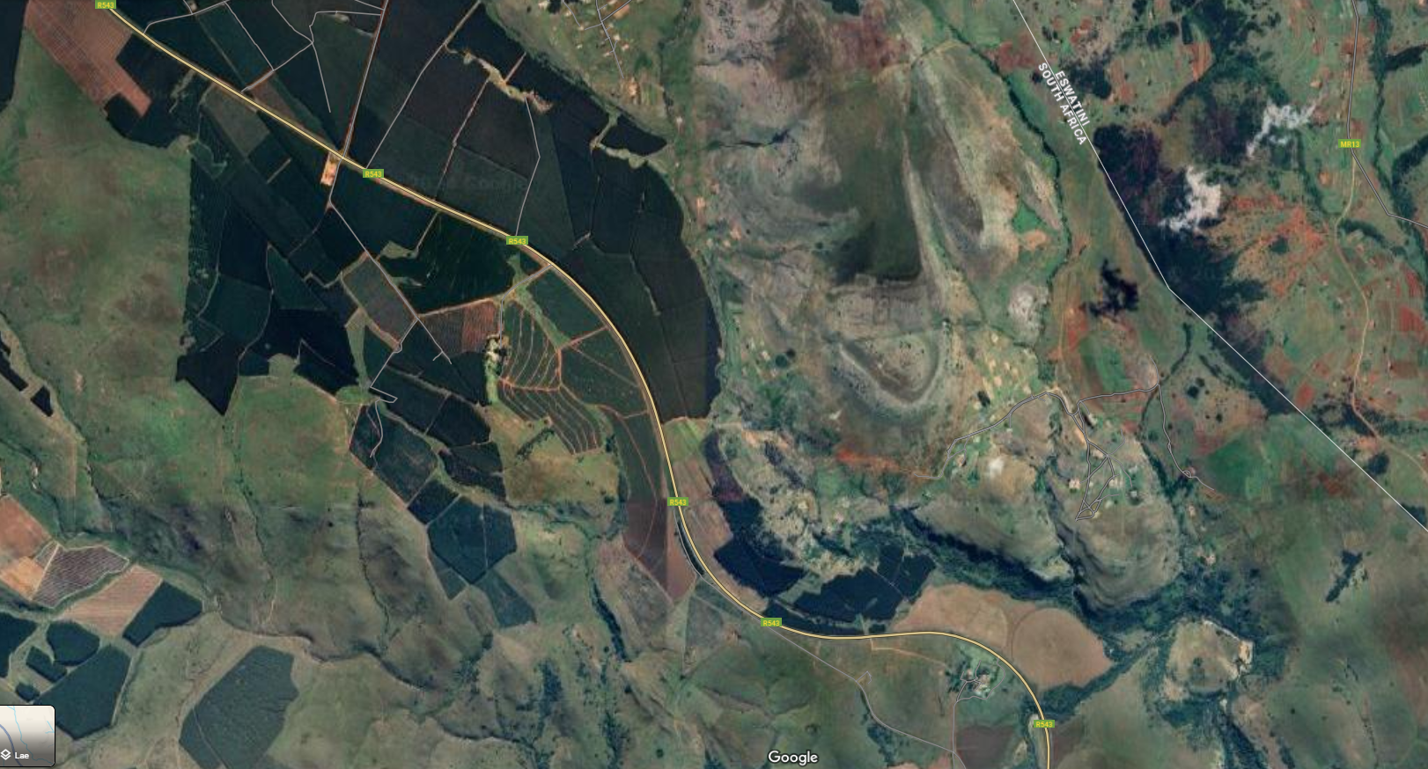

Continue to Assegaai River
Assegaai Marathon Route Map - 2026
Return to Rugby Club
Turnaround point for 42.2km at Assegaai River

Slide 4
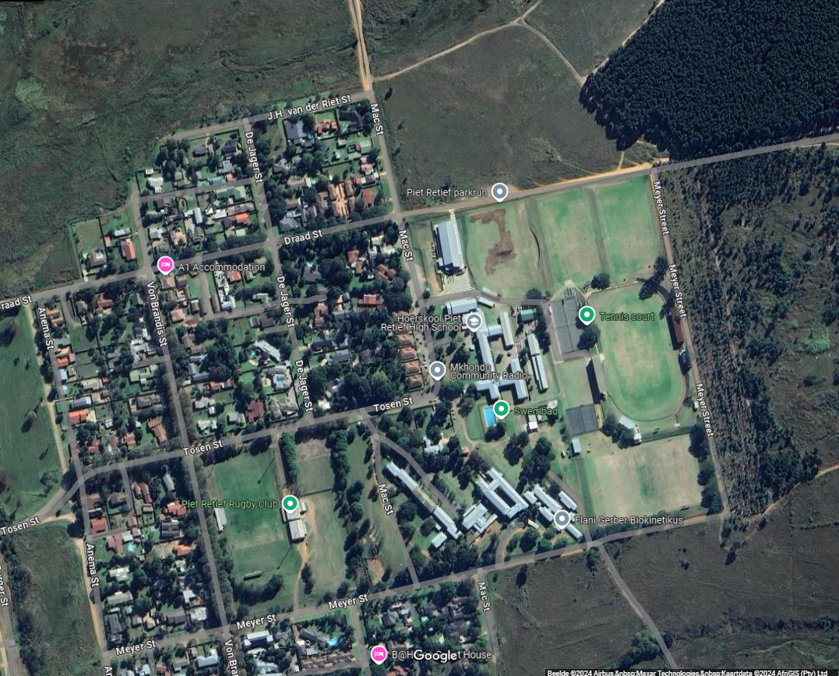
4km Route
Start
Finish

Slide 5
8
9
7
10
1
2
Start
6
Finish
5
4
3

Slide 6
1km Route
Start
Finish

Slide 7
1
2
Start
Finish
5
4
3

